Slide 1
Training model

Slide 2
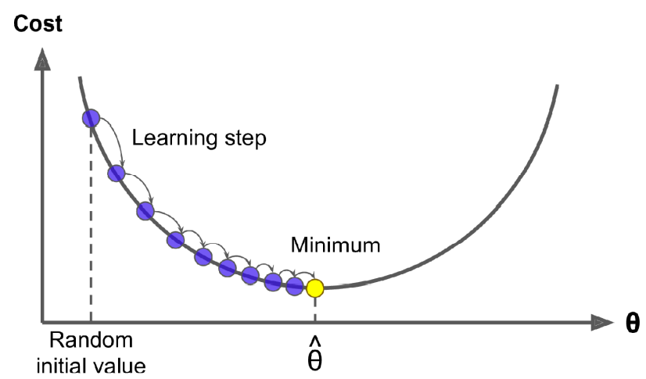
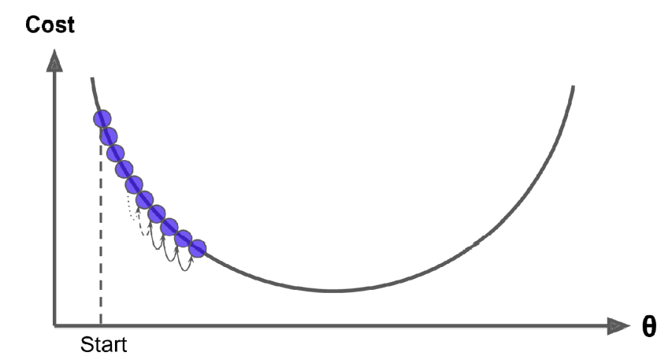
Learning rate
model parameters are initialized randomly and; the learning step size is proportional to the slope of the cost function, so the steps gradually get smaller as the parameters approach the minimum
learning rate is too small, then the algorithm will have to go through many iterations to converge, which will take a long time

Slide 3
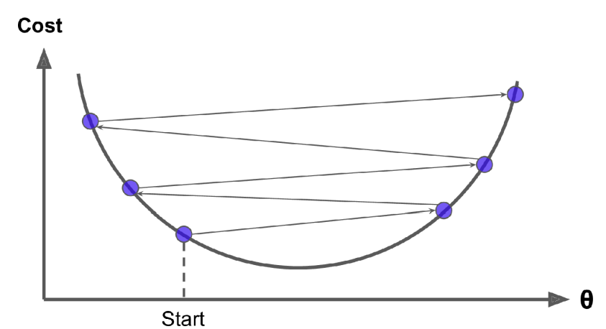
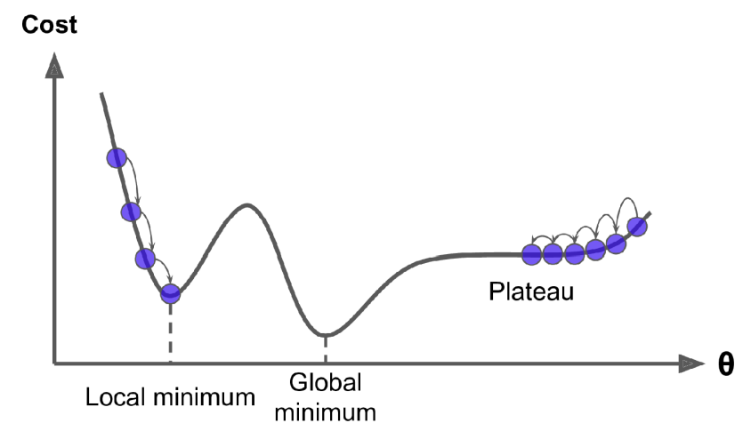
Learning rate
if the learning rate is too high, you might jump across the valley and end up on the other side, possibly even higher up than you were before
If the random initialization starts the algorithm on the left, then it will converge to a local minimum.
If it starts on the right, then it will take a very long time to cross the plateau

Slide 4

Gradient Descent in a Linear Regression model
the MSE cost function for a Linear Regression model happens to be a convex function
This implies that there are no local minima, just one global minimum
It is also a continuous function with a slope that never changes abruptly
These two facts have a great consequence:
Gradient Descent is guaranteed to approach arbitrarily close the global minimum if the learning rate is not too high

Slide 5
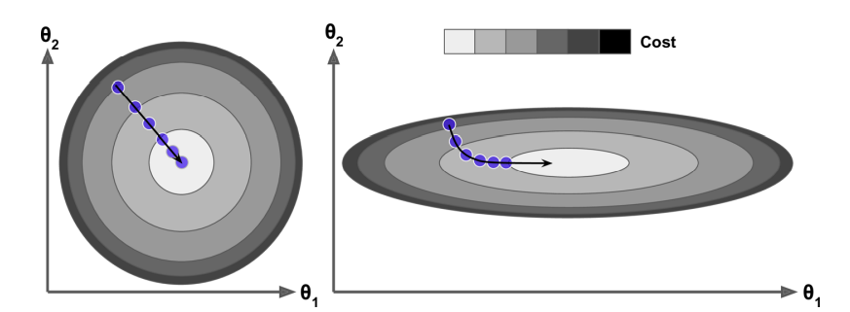
Necessary of scales
In fact, the cost function has the shape of a bowl, but it can be an elongated bowl if the features have very different scales
Gradient Descent algorithm goes straight toward the minimum, thereby reaching it quickly
Gradient Descent algorithm goes indirectly to the minimum, thereby taking long time
When using Gradient Descent, you should ensure that all features have a similar scale (e.g., using Scikit-Learn’s StandardScaler class), or else it will take much longer to converge.

Slide 6

Gradient descent
Once you have the gradient vector, which points uphill, just go in the opposite direction to go downhill.
η determine the size of the downhill step

Slide 7
Two Parameter setting
learning rate, you can use grid search
However, you may want to limit the number of iterations so that grid search can eliminate models that take too long to converge
number of iterations
If it is too low, you will still be far away from the optimal solution when the algorithm stops;
but if it is too high, you will waste time while the model parameters do not change anymore.
A simple solution is to set a very large number of iterations but to interrupt the algorithm when the gradient vector becomes tiny
when its norm becomes smaller than a tiny number ϵ(called the tolerance)

Slide 8
Content
Linear Regression
Gradient Descent
Batch Gradient Descent
Stochastic Gradient Descent
Mini-batch Gradient Descent
Polynomial Regression
Learning Curves
Regularized Linear Models
Logistic Regression

Slide 9
Necessary of Stochastic Gradient Descent
The main problem with Batch Gradient Descent is the fact that it uses the whole training set to compute the gradients at every step, which makes it very slow when the training set is large
At the opposite extreme, Stochastic Gradient Descent picks a random instance in the training set at every step and computes the gradients based only on that single instance
Obviously, working on a single instance at a time makes the algorithm much faster because it has very little data to manipulate at every iteration
It also makes it possible to train on huge training sets, since only one instance needs to be in memory at each iteration

Slide 10
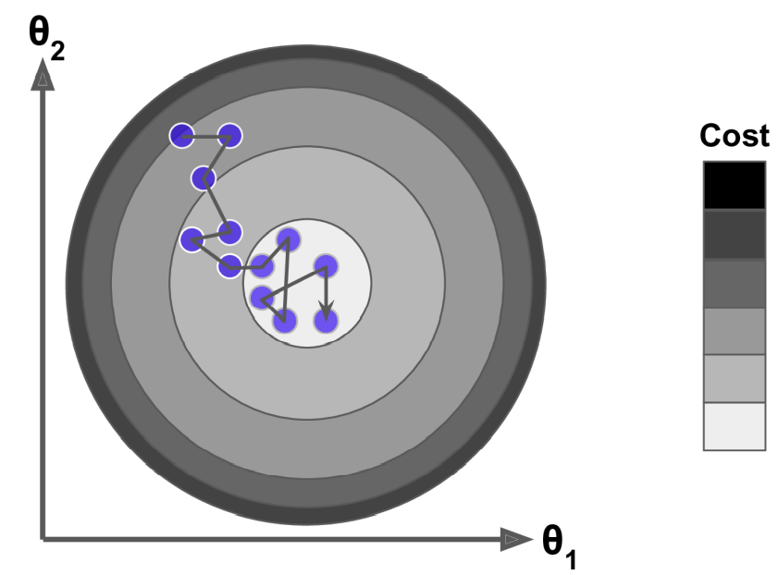
Shortcoming of Stochastic Gradient Descent
Due to its stochastic (i.e., random) nature, this algorithm is much less regular than Batch Gradient Descent:
instead of gently decreasing until it reaches the minimum, the cost function will bounce up and down, decreasing only on average.
Over time it will end up very close to the minimum, but once it gets there it will continue to bounce around, never settling down

Slide 11
Randomness’ help
When the cost function is very irregular, this can actually help the algorithm jump out of local minima
so Stochastic Gradient Descent has a better chance of finding the global minimum than Batch Gradient Descent does

Slide 12
Simulated annealing in SGD
Therefore, randomness is good to escape from local optima, but bad because it means that the algorithm can never settle at the minimum
One solution to this dilemma is to gradually reduce the learning rate
The steps start out large (which helps make quick progress and escape local minima), then get smaller and smaller, allowing the algorithm to settle at the global minimum
This process is akin to simulated annealing. I

Slide 13
learning schedule
The function that determines the learning rate at each iteration is called the learning schedule
If the learning rate is reduced too quickly, you may get stuck in a local minimum, or even end up frozen halfway to the minimum.
If the learning rate is reduced too slowly, you may jump around the minimum for a long time and end up with a suboptimal solution if you halt training too early

Slide 14
IID assumption
When using stochastic gradient descent, the training instances must be independent and identically distributed (IID) to ensure that the parameters get pulled toward the global optimum, on average
A simple way to ensure this is to shuffle the instances during training
if the instances are sorted by label— then SGD will start by optimizing for one label, then the next, and so on, and it will not settle close to the global minimum

Slide 15
Mini-batch GD
at each step, Mini-batch GD computes the gradients on small random sets of instances called mini-batches, instead of computing the gradients
based on the full training set (as in Batch GD)
based on just one instance (as in Stochastic GD)
The main advantage of Minibatch GD over Stochastic GD is that you can get a performance boost from hardware optimization of matrix operations, especially when using GPUs

Slide 16
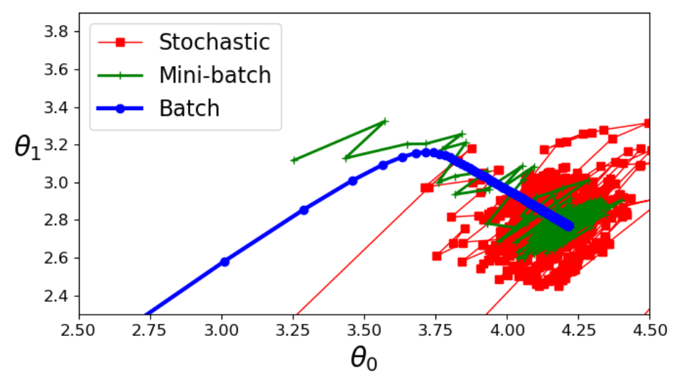
Progress in parameter space
They all end up near the minimum, but Batch GD’s path actually stops at the minimum, while both Stochastic GD and Mini-batch GD continue to walk around
However, don’t forget that Batch GD takes a lot of time to take each step, and Stochastic GD and Mini-batch GD would also reach the minimum if you used a good learning schedule

Slide 17
Progress in parameter space
Mini-batch GD’s progress in parameter space is less erratic than with Stochastic GD
As a result, Minibatch GD will end up walking around a bit closer to the minimum than Stochastic GD—but it may be harder for it to escape from local minima

